Slide 1
E-Commerce sales Dashboard
By:
Kavimalar M

Slide 2
Introduction
This project presents an E-Commerce Sales Dashboard created using Microsoft Power BI.
The dashboard helps to analyze large-scale sales data and converts it into meaningful insights using interactive visualizations. It enables better understanding of business performance and supports data-driven decision making.

Slide 3
Objective
ThisTo analyze overall sales performance
To track revenue, orders, and customer data
To identify top-performing states and products
To understand customer purchasing behavior
To analyze payment methods and order status
To support business decision-making

Slide 4
Selecting visual aids
The dataset used is Brazilian E-Commerce Public Dataset by Olist.
It includes:
Customer details (ID, state, city)
Order details (order ID, purchase date, status)
Product details (product ID, category)
Payment details (payment type, payment value)
Order items (price, freight value)

Slide 5
Tools used
Excel → Data cleaning
Power BI → Dashboard creation
Power Query → Data transformation
DAX → Calculations and KPIs

Slide 6
KPI CARDS EXPLANATION
The dashboard includes key performance indicators:
Total Revenue (13.59M) → Total income generated
Total Orders (98.67K) → Total number of orders
Total Customers (96.10K) → Unique customers count
Total Categories (74) → Number of product categories
These KPIs provide a quick overview of business performance.

Slide 7
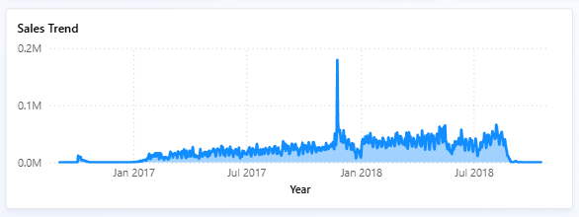
Sales trend analysis
The line chart shows sales trend over time.
Sales increased gradually during 2017
A peak is observed around early 2018
Fluctuations indicate seasonal demand
Helps in identifying growth periods and planning strategies.

Slide 8
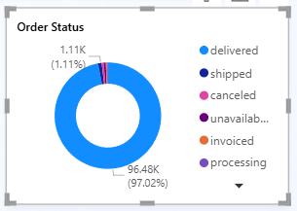
ORDER STATUS ANALYSIS
The donut chart represents order distribution:
Majority of orders are Delivered (~97%)
Very few orders are cancelled or unavailable
Indicates strong operational efficiency.

Slide 9
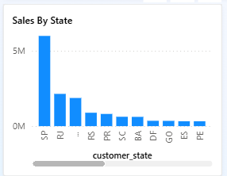
Sales by state
The bar chart shows revenue by customer state:
SP (São Paulo) has highest sales
Followed by RJ and MG
Other states contribute less
Helps in regional performance analysis.

Slide 10
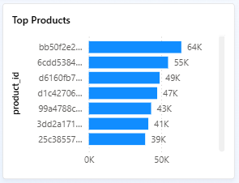
TOP PRODUCTS ANALYSIS
The chart shows top-performing products by revenue.
Few products contribute major revenue
Identifies high-demand items
Useful for inventory and marketing focus

Slide 11
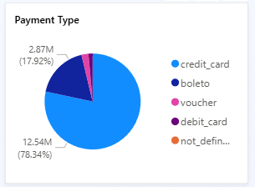
PAYMENT ANALYSIS
The pie chart shows payment distribution:
Credit card (~78%) is most used
Boleto is second highest
Other methods are minimal
Helps understand customer payment preferences.

Slide 12
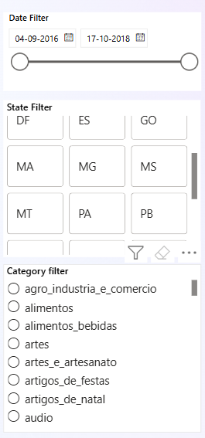
FILTERS & INTERACTIVITY
The dashboard includes filters:
Date range filter
State filter
Product category filter
Users can interact and explore data dynamically.

Slide 13
Key insights
Majority of revenue comes from few states
Most orders are successfully delivered
Credit card is dominant payment method
Sales show seasonal fluctuations
Certain products drive major revenue

Slide 14
conclusion
The dashboard provides a clear view of business performance by combining multiple data sources.
It helps businesses:
Understand sales trends
Improve customer targeting
Optimize product strategy
Make informed decisions

Slide 15
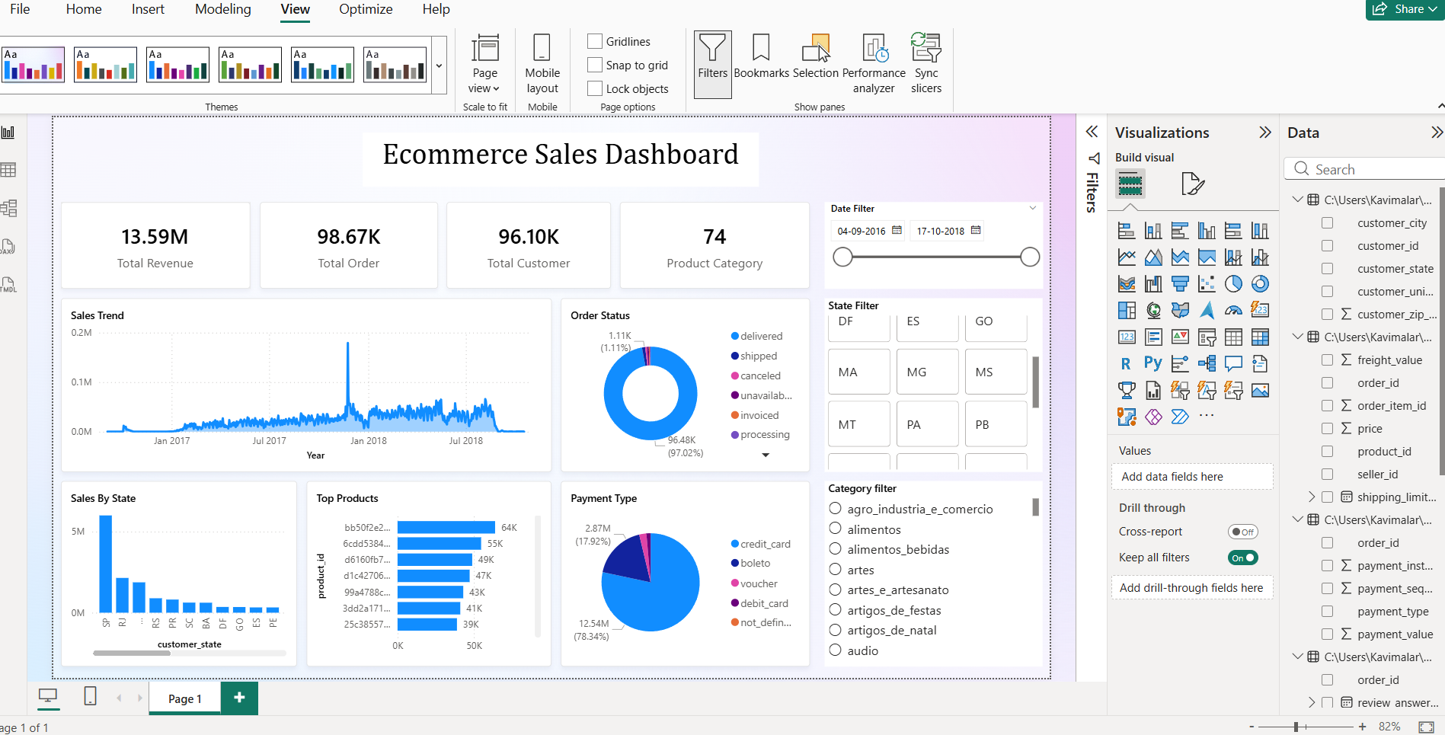
Dashboard(output)

Slide 16
Thank you

